Slide 1
8-1 Arc Length

Slide 2
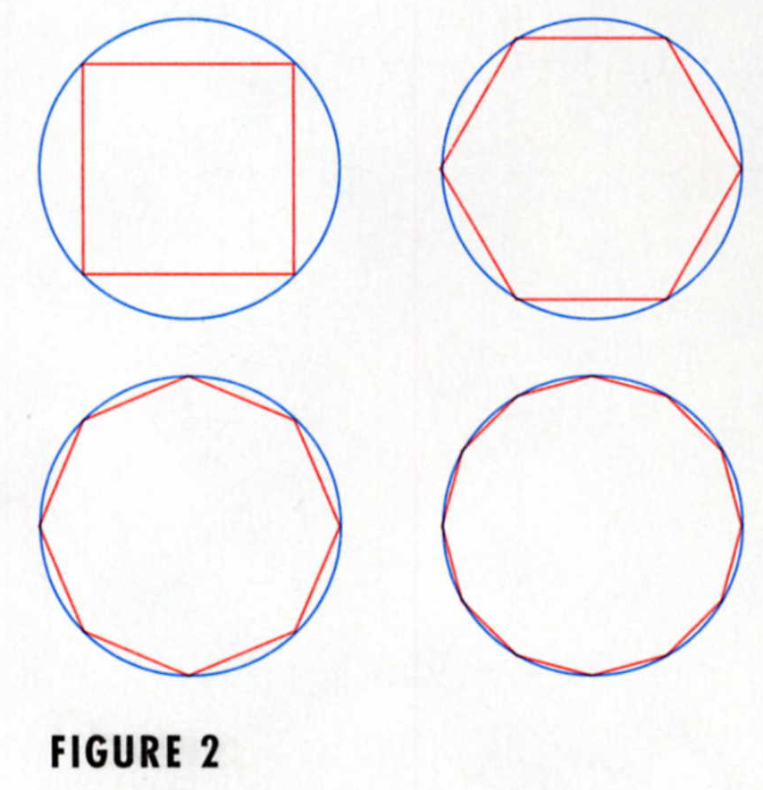
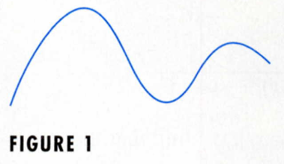
We might think of fitting a piece of string to the curve in Figure 1.
Figure 1
This process is familiar for the case of a circle, the circumference is the limit of lengths of inscribed polygons.

Slide 3
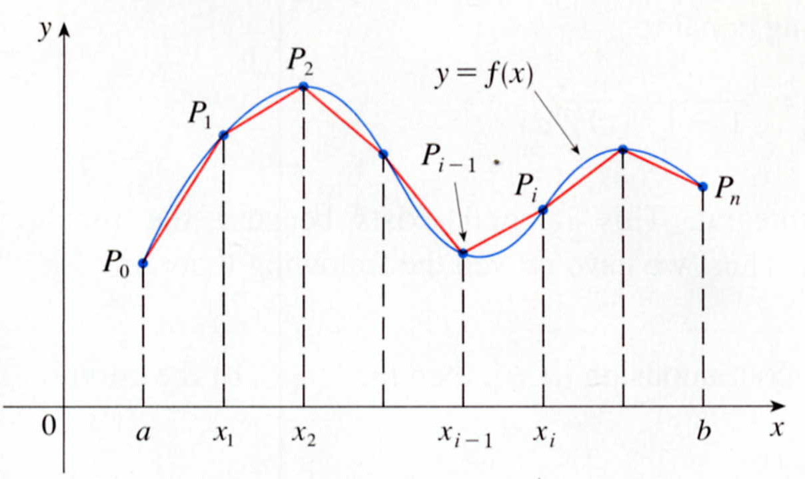
The equation y = f (x) , a ≦x ≦b
the interval [ a, b ]
Into n subintervals with endpoints x₀, x₁,……, x_{n}
equal width △X
If y_{i} = f (x_{i})
y = f (x)
P_{i} (x_{i}, y_{i})
The polygon with vertices P₀, P₁, …., P_{n}

Slide 4
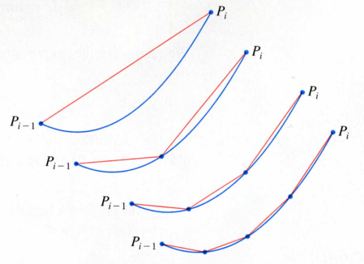
Arc of the curve between P_{i-1} and P_{i} has been magnified.
P_{i}
y = f(x)
P_{i}
P_{i}
P_{i-1}
P_{i}
P_{i}
P_{i-1}
P_{i-1}
x_{i-1} x_{i}
P_{i-1}
P_{i-1}
Approximations with successively smaller values of △X are shown.

Slide 5
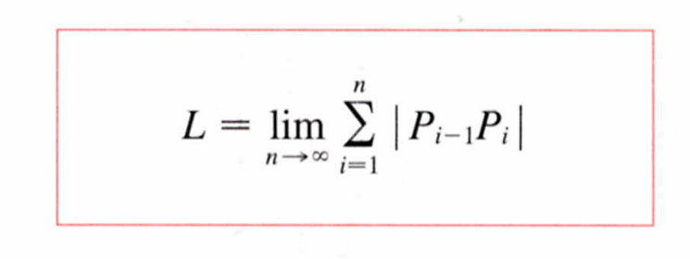
The length L of the curve C
y = f(x) , b ≧x ≧a
n
L =
lim
｜P_{i-1}P_{i}｜
n→∞
i=1

Slide 6
A function f is called smooth.
Small change in x produces a small change in f ’(x)
y_{i} = y_{i} – y_{i-1}
P_{i-1}P_{i}
=
(x_{i} – x_{i-1})² + (y_{i} – y_{i-1})²
=
( x)² + ( y_{i})²
P_{i-1}
P_{i}
yi
xi
y_{i-1}
y_{i}
x_{i-1}
x_{i}

Slide 7
Mean Value Theorem to f(x) on the internal [ x_{i-1}, x_{i}]
X_{i}* between x_{i-1} and x_{i}
f (x_{i}) – f(x_{i-1}) = f’(x_{i}*) (x_{i} – x_{i-1})
y_{i} = f’(x_{i}*) x
P_{i-1}P_{i}
=
( x)² + ( y_{i})²
=
( x)² + [ f’(x_{i}*) x ]²
=
1 + [ f’(x_{i}*) ]² ( x )²
=
1 + [ f’(x_{i}*) ]² ( x )
(since △x＞0)

Slide 8
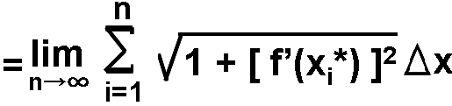

By Definition 1,
n
L =
lim
｜P_{i-1}P_{i}｜
n→∞
i=1
=
1 + [ f’(x_{i}*) ]² dx

Slide 9
The Arc Length Formula
If f’(x) is continuous on [a, b], then the length of the curve y = f(x), a≦x≦b, is
L =
f’(x)
1 + [ ]² dx
Use Leibniz notation for derivatives,
dy
L =
1 + ( )² dx
dx

Slide 10

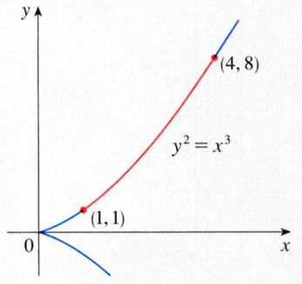

EXAMPLE 1 Find the length of the arc of the semicubical parabola y² = x³ between the points (1, 1) and (4, 8).
SOLUTION
L =
1 + (dy/dx)²
dx
y = x^{3/2},
dy/dx = 3/2‧x^{1/2}
=
1 + (9x/4)
dx
u = 1 + 9x/4,
=
u du
du = 9/4‧dx,
x = 1, u = 13/4
1
x = 4, u = 10
=
( 80 10 - 13 13 )
27

Slide 11

The Arc Length Formula
If g’(y) is continuous on [c, d], then the length of the curve x = g(y), c≦y≦d, is
L =
g’(y)
1 + [ ]² dy
Use Leibniz notation for derivatives,
dx
L =
1 + ( )² dy
dy

Slide 12



EXAMPLE 2 Find the length of the arc of the parabola y² = x from (0, 0) to (1, 1).
SOLUTION
dx
L =
1 + ( )² dy
x = y²,
dy
dx = 2ydy
=
1 + 4y² dy
y = ½ tanθ,
2
=
2
dy = ½ secθdθ
1 + tan²θ
½ secθdθ
y = 0, tanθ=0, θ=0
=
½ sec³θdθ
y = 1, tanθ=2,
θ=tan⁻¹2=α
2
u = secθ
dv = sec θdθ
du = secθtanθdθ
v = tanθ

Slide 13
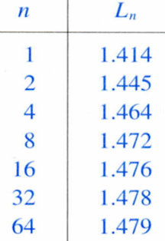
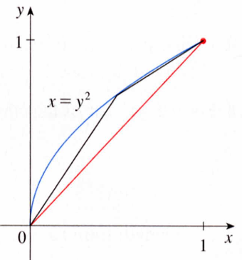
α
=
1/2‧1/2[ secθtanθ+ ln︳secθ+tanθ︳]
0
=
1/4[ secαtanα+ ln︳secα+tanα︳]
5
In( + 2)
5
=
+
2
4
tanα= 2
≒ 1.478943
secα= 5
n
L_{n}
(1, 1)
1248
1.4141.4451.4641.4721.4761.4781.479
y=x²
163264
(0, 0)

Slide 14

EXAMPLE 3 (a) Set up an integral for the length of the arc of the hyperbola xy = 1 from the point (1, 1) to the point (2, ½).
(b) Use Simpson’s Rule with n = 10 to estimate the arc length.
SOLUTION
dy
L =
=
1
（a）
1 + ( )² dx
1 + dx
dx
x⁴
y = 1/x ,
=
dx
dy = -1/x² dx
1+ 1/x⁴
（b）
n = 10, △x = 0.1, f(x) =
1+ 1/x⁴
△x
dx
≒
[ f(1)+4f(1.1)+2f(1.2)+…+f(2) ]
1+ 1/x⁴
3
≒1.1321
(Simpson’s Rule, 7-7)

Slide 15

The Arc Length Function
A smooth curve C
y = f(x), a≦ x ≦b
起点
Let s(x) be the distance along C
終点
P₀(a, f(a)) to the point Q(x, f(x)).
called the arc length function.
s(x) =
1 + [ f’(t)]² dt

Slide 16
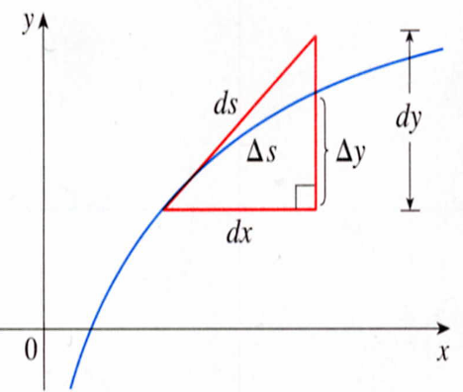
s(x) =
1 + [ f’(t)]² dt
ds
dy
=
1 + [ f’(x)]²
=
1 + ( )²
dx
dx
y
ds
=
dy
1 + ( )²
dx
dx
ds
dy
(ds)² = (dx)² + (dy)²
dx
ds
=
dx
1 + ( )²
dy
dy
x

Slide 17
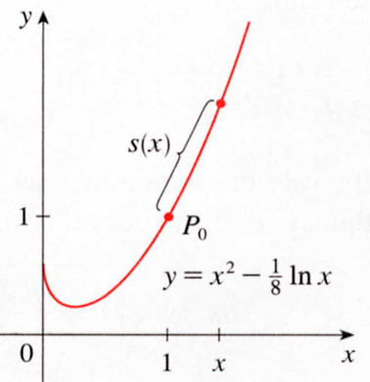
EXAMPLE 4 Find the arc length function for the curve y = x² -1/8 lnx taking P₀(1, 1) as the starting point.
SOLUTION
s(x) =
1 + [ f’(t)]² dt
f(x) = x² -1/8 lnx ,
f’(x) = 2x -1/8x ,
=
1 + [2t – 1/8t]² dt
=
( 2t + 1/8t )² dt
S(x)
1
p_{o}
=
( 2t + 1/8t ) dt
y=x²-1/8lnx
x
=
x² + 1/8 lnx -1
1

Slide 18
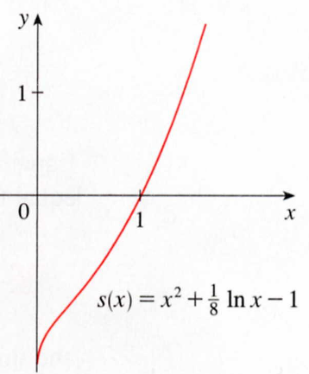
=
s(x) =
x² + 1/8 lnx -1
For example:
The curve from (1, 1) to (3, f(3))
S(3) = 3² + 1/8 ln3 - 1
≒ 8.1373
f(x) = x² -1/8 lnx ,
S(x)
P₀(1, 1)
1
x
s(x) = x² + 1/8 lnx -1
x

Slide 19
8-1 Exercises
EX9 , EX29,

